Slide 1

Basics of Web Design
Fifth Edition
Chapter 6
More C S S Basics
Key Concepts
Copyright © 2019 Pearson Education, Inc. All Rights Reserved
Notes:
If this PowerPoint presentation contains mathematical equations, you may need to check that your computer has the following installed:
1) Math Type Plugin
2) Math Player (free versions available)
3) NVDA Reader (free versions available)

Slide 2
Learning Outcomes
Describe and apply the C S S Box Model
Configure width and height with C S S
Configure margin, border, and padding with C S S
Center web page content with C S S
Apply shadows with C S S 3
Configure rounded corners with C S S 3
Configure background images with C S S 3
Configure opacity, R G B A color, H S L A color and gradients with C S S 3

Slide 3
Width and Height with C S S
Unit | Purpose
px | Configures a fixed number of pixels as the value
em | Configures a value relative to the font size
% | Configures a percentage value of the parent element
vh | Configures a value relative to 1% of the viewport height
vw | Configures a value relative to 1% of the viewport width

Slide 4
Width and Height C S S Properties
width property
Configures the width of an element’s content
h1 { width: 80%; }
min-width property
Configures minimum width of an element
max-width property
Configures the maximum width of an element
height property
Configures the height of an element
h1 { height: 100px; }

Slide 5
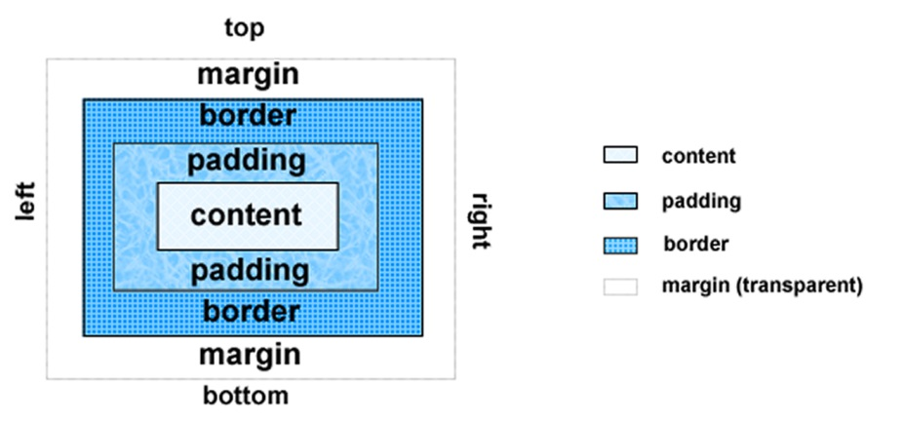
The Box Model
Content
Text & web page elements in the container
Padding
Area between the content and the border
Border
Between the padding and the margin
Margin
Determines the empty space between the element and adjacent elements

Slide 6

Configure Margin with C S S
The margin property
Related properties:
margin-top, margin-right, margin-left, margin-bottom
Configures empty space between the element and adjacent elements
Syntax examples
h1 { margin: 0; }
h1 { margin: 20px 10px; }
h1 { margin: 10px 30px 20px; }
h1 { margin: 20px 30px 0 30px; }
Configuration starts as top, right, bottom, and left.

Slide 7
Configure Padding with C S S
The padding property
Related properties:
padding-top, padding-right, padding-left, padding-bottom
Configures empty space between the content of the H T M L element (such as text) and the border
Syntax examples
h1 { padding: 0; }
h1 { padding : 20px 10px; }
h1 { padding : 10px 30px 20px; }
h1 { padding : 20px 30px 0 30px; }

Slide 8

The C S S border Property
Configures a border on the top, right, bottom, and left sides of an element
Consists of
border-width
border-style
border-color
h2 { border: 2px solid #ff0000 }

Slide 9
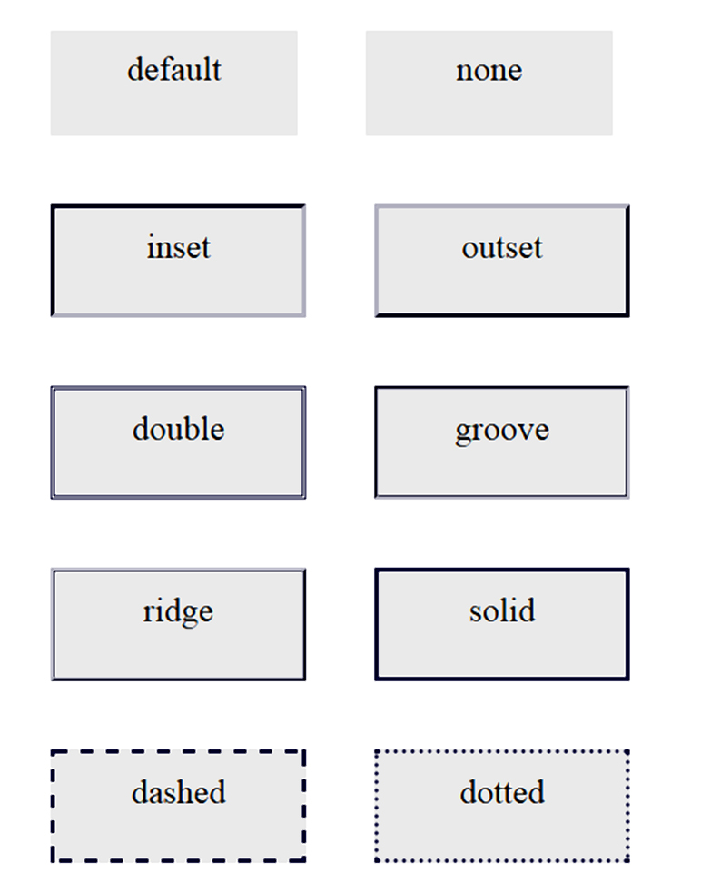
Valid border-style Values

Slide 10

Configuring Specific Sides of a Border
Use C S S to configure a line on one or more sides of an element
border-bottom
border-left
border-right
border-top
h2 { border-bottom: 2px solid #ff0000 }

Slide 11
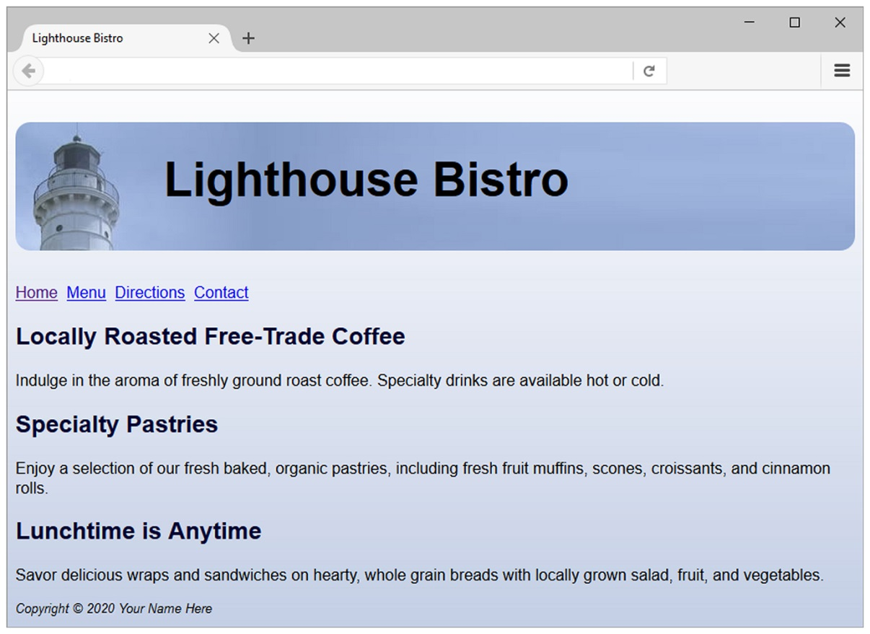
C S S Rounded Corners
border-radius property
Example:
h1 { border: 1px solid #000033;
border-radius: 15px; }

Slide 12
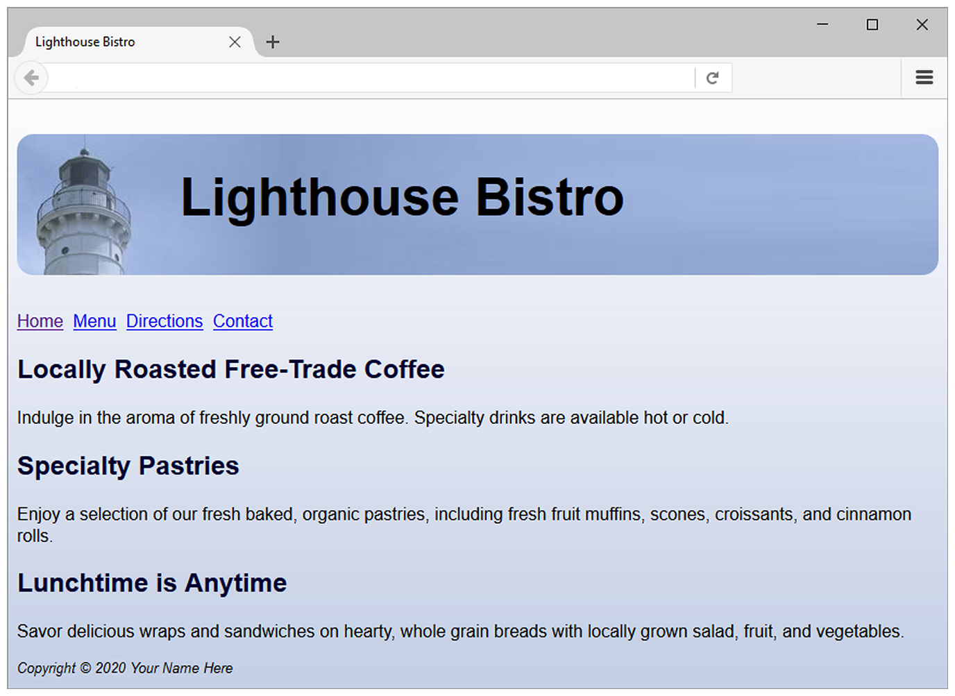
Centering Page Content with C S S
#container { margin-left: auto;
margin-right: auto;
width:80%; }

Slide 13
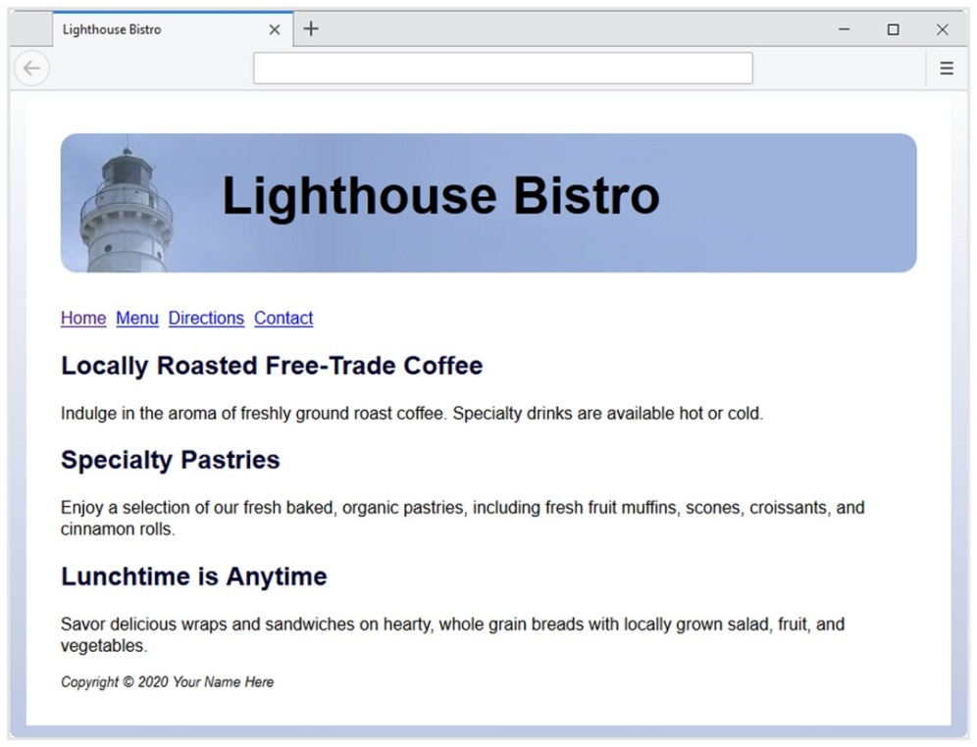
C S S 3 box-shadow Property
Configure the horizontal offset, vertical offset, blur radius, and valid color value
Example:
#wrapper { box-shadow: 25px 5px 5px #828282;}
Note: Optional keyword: inset

Slide 14
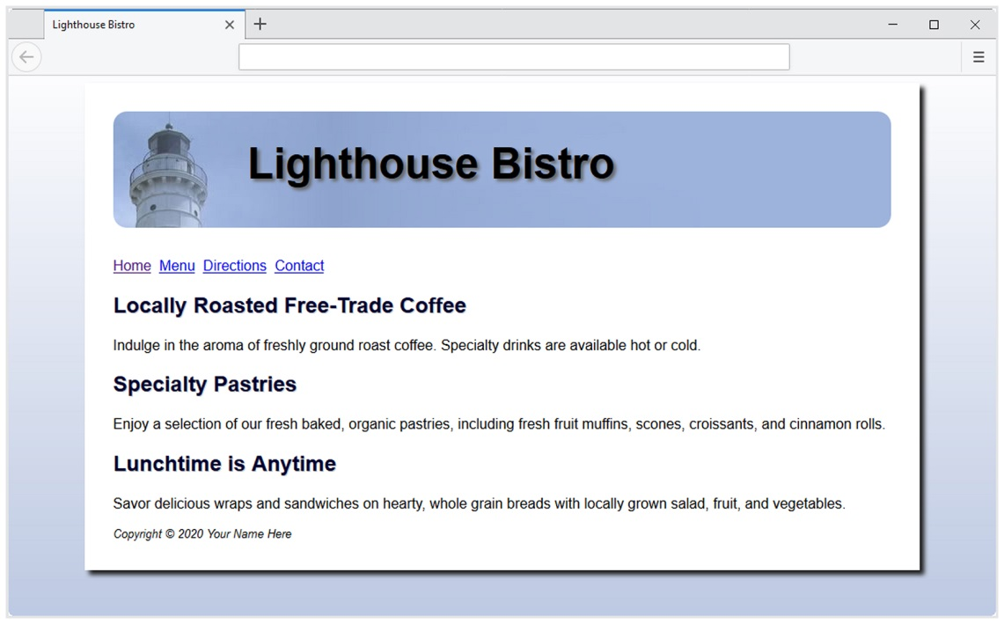
C S S 3 text-shadow Property
Configure the horizontal offset, vertical offset, blur radius, and valid color value
Example:
#wrapper { text-shadow: 3px 3px 3px #666; }

Slide 15
C S S Background Image Properties
background-clip
confines the display of the background image or color. Values are: border-box, padding-box, and content-box
background-origin
positions the background image relative to the content, padding or border. Values are: border-box, padding-box, and content-box
background-size
can be used to resize or scale the background image. Values are: keyword, one-value, two-value, and multiple background.

Slide 16
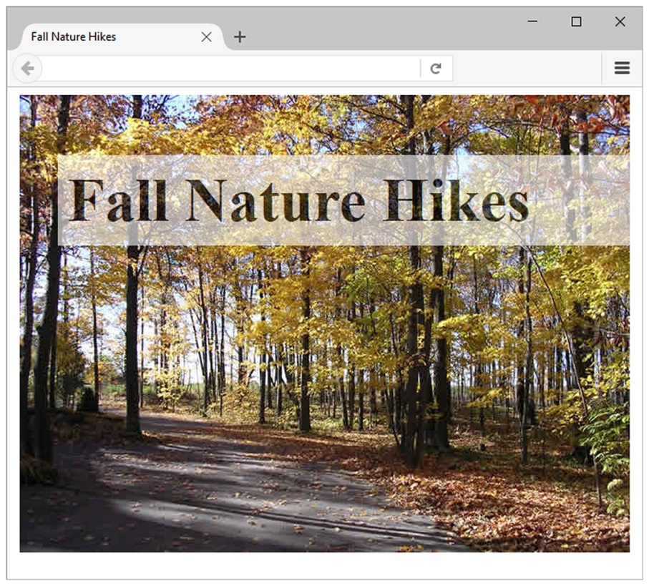
C S S opacity Property
Configure the opacity of the background color
Opacity range:
0 Completely Transparent
1 Completely Opaque horizontal offset, vertical offset, blur radius, and valid color value
Example:
h1{ background-color: #F F F F F F;
opacity: 0.6; }

Slide 17
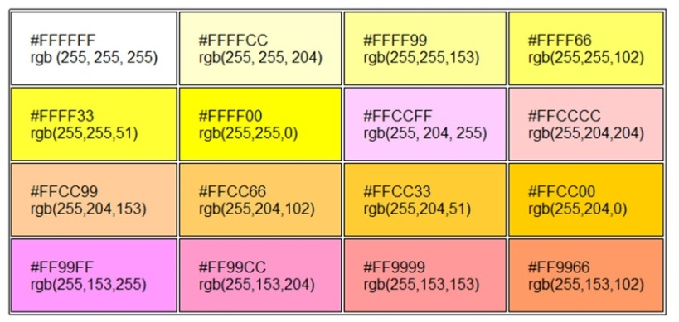
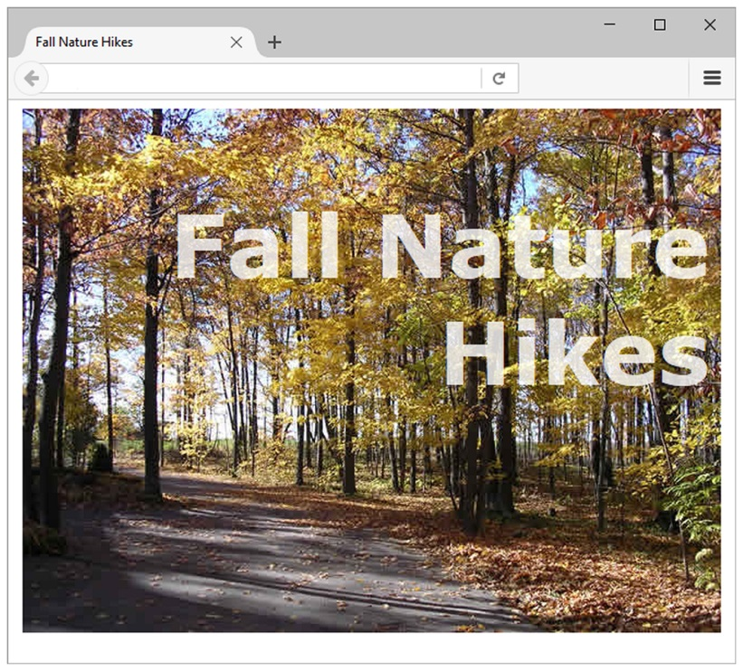
R G B A Color
Four values are required:
red color, green color, blue color, and alpha(transparency)
The values for red, green, and blue must be decimal values from 0 to 255.
The alpha value must be a number between 0 (transparent) and 1 (opaque).
Example:
h1 { color: #ffffff;
color: rgba(255, 255, 255, 0.7);
font-size: 5em; padding-right: 10px;
text-align: right; font-family: Verdana, Helvetica, sans-serif;
}

Slide 18
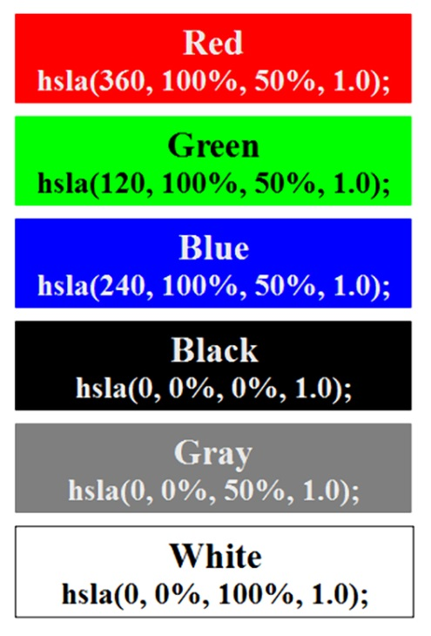
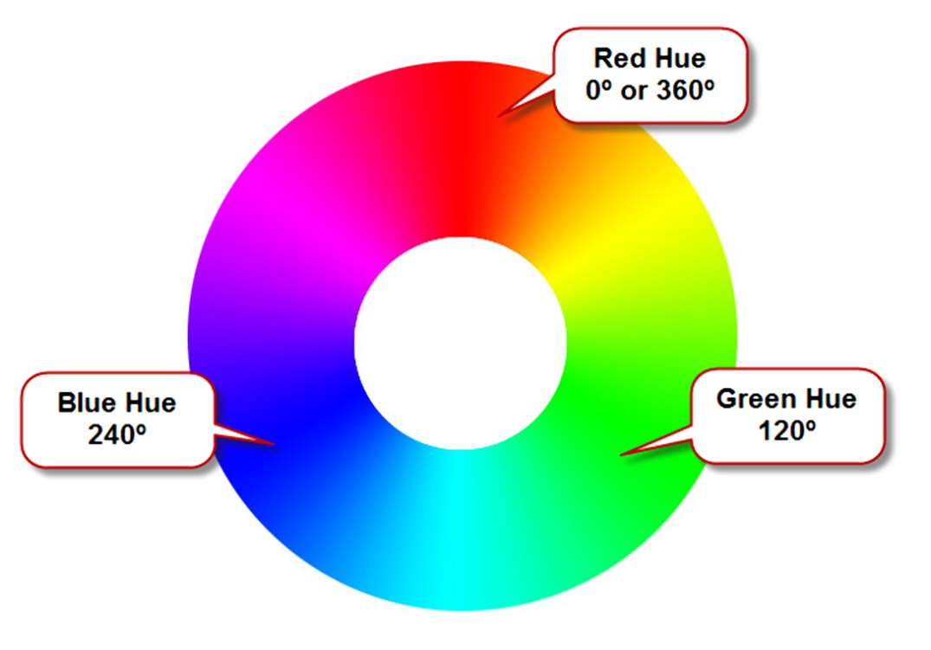
H S L A Color
hue, saturation, light, alpha
Hue is a value between 0 and 360
Saturation: percent
Lightness: percent
Optional alpha: from 0 to 1

Slide 19
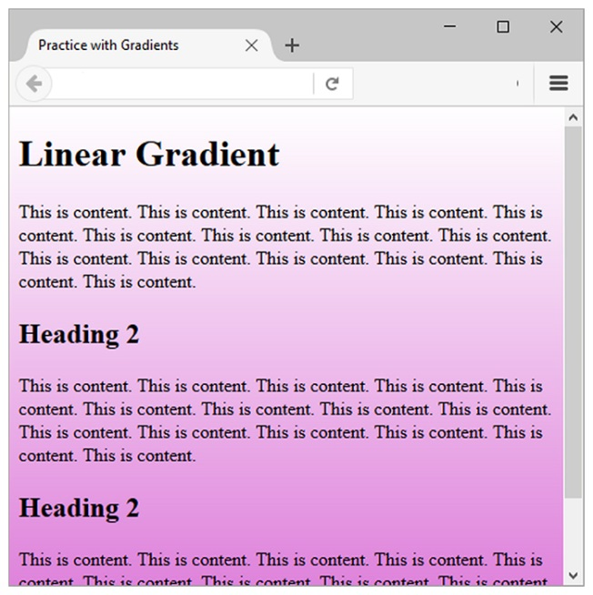
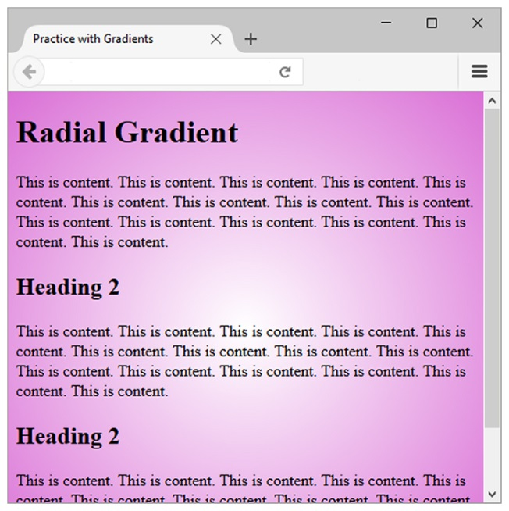
C S S Gradients
Gradient: a smooth blending of shades from one color to another
Use the background-image property
Linear Gradient Example
body { background-color: #8F A 5 C E;
background-image: linear-gradient (to bottom, #F F F F F F, #8F A 5 C E);
}
Radial Gradient Example
body { background-color: #8F A 5 C E;
background-image: radial-gradient(#F F F F F F, #0000F F);
}

Slide 20
C S S Gradients
You can also set a starting point and a direction (or an angle) along with the gradient effect in linear gradient.
Syntax: background-image: linear-gradient(direction, color, color);
Direction values: to bottom, to top, to right, to left.
For diagonal use two directions: to bottom right, to top left, etc

Slide 21
Summary
This chapter expanded your C S S skillset.
You were introduced to the box model.
You configured C S S properties related to the box model, such as margin, border, padding, height, and width.
You centered a web page using C S S.
You explored new C S S properties including: border-radius, box-shadow, text-shadow, opacity.

Slide 22

Copyright
This work is protected by United States copyright laws and is provided solely for the use of instructors in teaching their courses and assessing student learning. Dissemination or sale of any part of this work (including on the World Wide Web) will destroy the integrity of the work and is not permitted. The work and materials from it should never be made available to students except by instructors using the accompanying text in their classes. All recipients of this work are expected to abide by these restrictions and to honor the intended pedagogical purposes and the needs of other instructors who rely on these materials.

